Slide 1
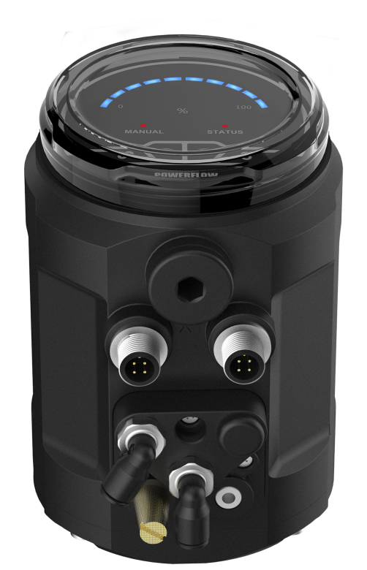
1500 Series Intelligent Electropneumatic Valve Positioner
Electrical waterproof connectors
LED display
Easy to start-up
Technical data
Material | PC、PA6-GF30、SI
Power supply | 24V DC ±10%
Set-point signal | 4 – 20 mA
Input resistance for set-point signal | 120Ω
Control medium Dust concentration Particle density Pressure condensation point Oil concentration | neutral gases, air DIN ISO 8573-1 Solid particle size and density Class 3 Dew point Class 3 Oil content Class 3
Ambient temperature | 0-70°C
Pneumatic connection | Plug-in hose connector G1/4(internal Φ6mm
Electrical connection | M12 3-pins B-coded (cable ø 4-6mm) M12 4-pins D-coded (cable ø 4-6mm)
Supply pressure | 3~7 bar, specific values depending on the actuator
Air flow rate | 17 l/min(input pressure of 0.6Mpa) 58 l/min(input pressure of 0.6Mpa ,only single-acting)
Stroke control range | Line 5-50mm Angle 90°
Installation | As required, Preferably with actuator in upright position, Screw
Protection class | IP66
Power consumption | <5W
1500 series intelligent electropn-eumatic valve positioner is designed for integral pneumatic control valve, particularly suitable for angle seat valves and diaph-ragm valves.
The product is easy to operate. It can easily be operated via the keypad.
The positioner adjusts the valve position quickly and accurately through detecting the position sensor signal.

Slide 2
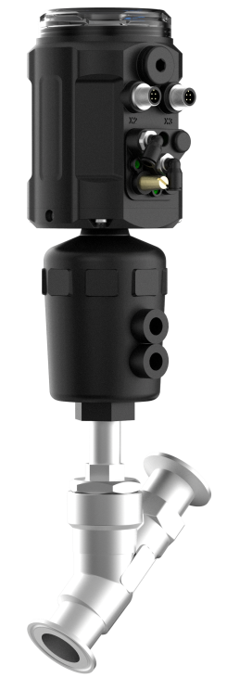
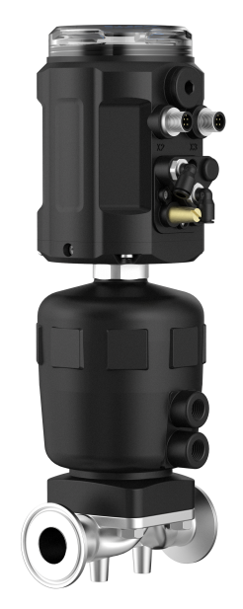
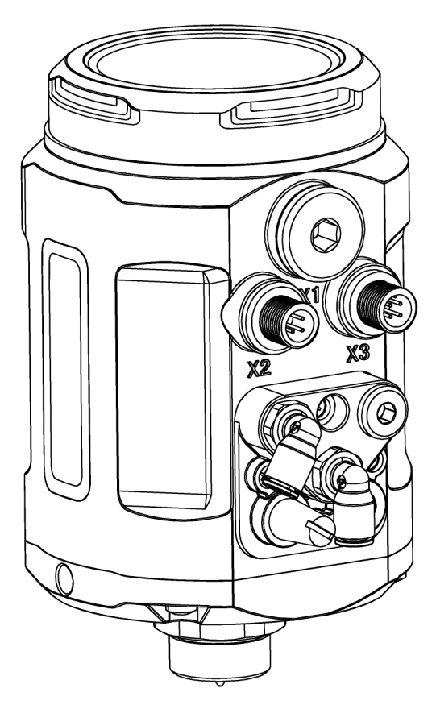
Combinations
Diaphragm control valve
Angle seat control valve
Structure
1
Protective cover
Main body casing
Electrical connection
Pneumatic connection
Actuator connection
2
3
4
5

Slide 3
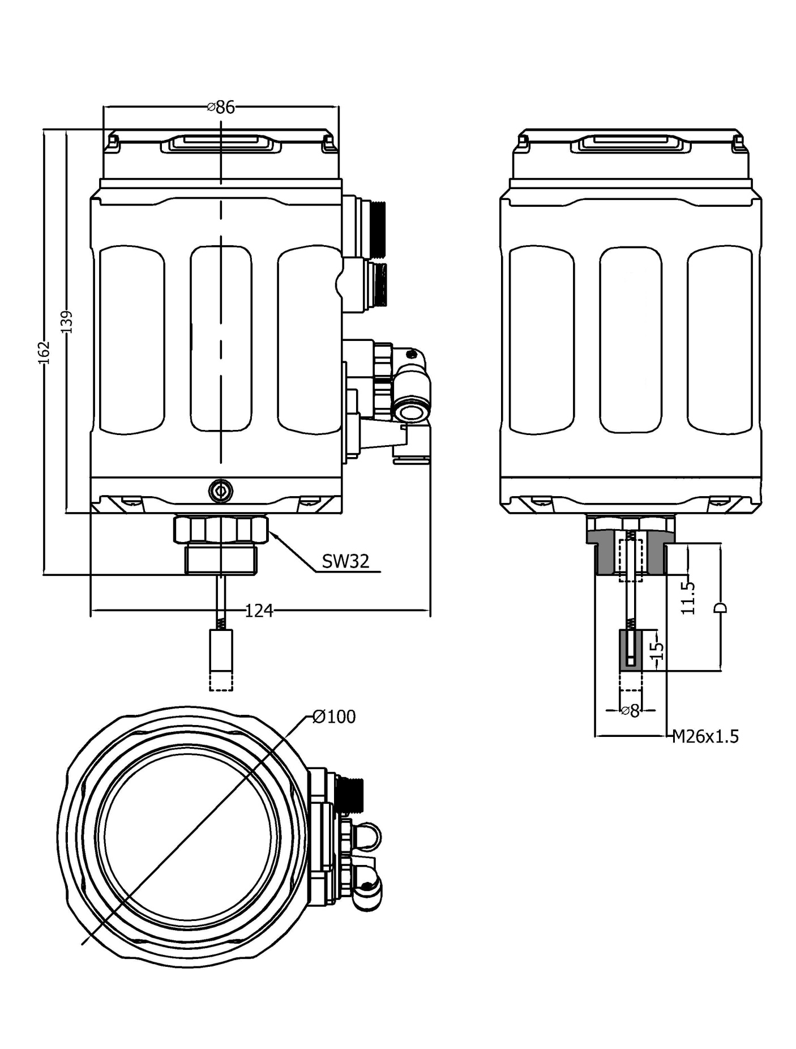
Dimensions

Slide 4
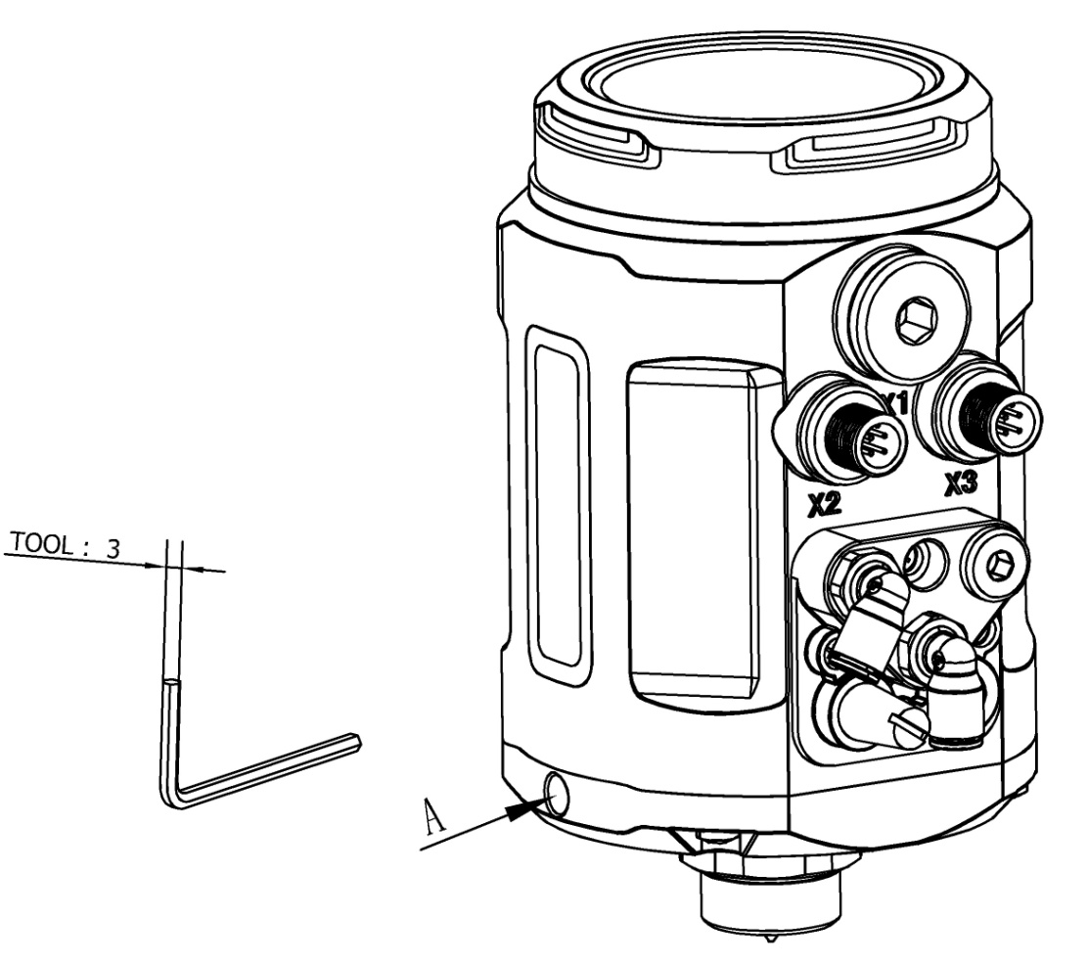
  Interface angle adjustment
The angle can be adjusted between the positioner and the valve. If need to adjust the interface angle, relaxing the hexagon screw in place A first. Then adjusting the angle clockwise or counter-clockwise in 180°range. After adjusting the angle, locking the angle by the hexagon screw.
180°
180°

Slide 5
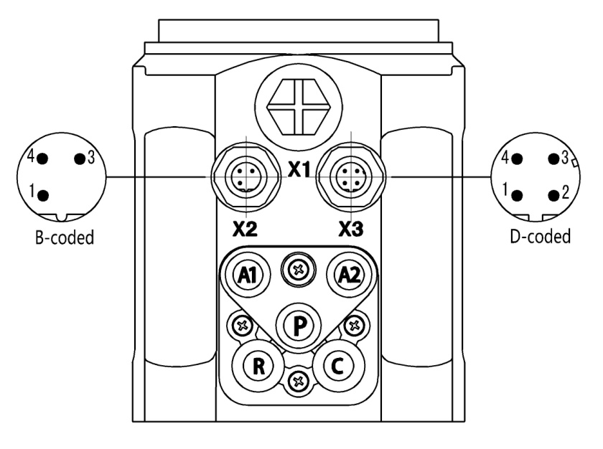
Electrical connections
X2(optional)
Pin | Description | Signal type
1 | Analogue signal output + | 4 – 20 mA
3 | Analogue signal output GND | GND
4 | NC | NULL
X3
Pin | Description | Signal type
1 | Power supply + | +24 V
2 | Power supply GND | GND
3 | Set signal input + | 4 – 20 mA
4 | Set signal input GND | GND
Pneumatic connections
P | Air supply enter(built-in filter, filter size 5 μm)
R | Air exhaust
C | Check valve
A1 | Pilot air outlet 1
A2 | Pilot air outlet 2

Slide 6
Technical specifications
N No feedback signal
Y 4-20mA feedback signal
Feedback signal
S Single-acting
D Double-acting
Actuator type
S2 Line 5-25 mm
S3 Line 25-50 mm
S4 Angle 90°
Valve max stroke
Q1 17 l/min
Q2 58 l/min
Air flow rate
T1 G1/4
T2 M16 * 1
T3 M22 * 1.5
T4 M26 * 1.5
Thread type
S Safe
F Freeze
Power off state for single-acting
1500
N
S
S2
Q1
T1
S
Remark:
In the air flow rate option, code Q1 is suggested to match the actuator of 40-100 mm internal gas chamber diameter, code Q2 is suggested to match the actuator of 125-160 mm internal gas chamber diameter. Code Q2 is only used for single-acting actuator, and only in Freeze state when power-off. The air flow rates for code Q1 and Q2 are under the condition of 0.6Mpa input pressure.
In the valve max stroke option, AT actuator range for code S4 is AT50~AT125. For other actuator models, please consult our company. It is no need to select the thread type option for code S4.
Power off state for single-acting option is Safe by default.

Slide 7
Signal flow diagram
B1
Z1
Valve opening
CMD
Xd1
E1
Position setpoint
Positioner
Pilot valve system
Control valve
Position sensor system
Schematic diagram
Operation through keypad
Input
Output(optional)
Set-point signal
4-20mA
Positioner
Feedback signal
4-20mA
Power supply
24V DC

Slide 8
Function comparison for all types
FUNCTION | 1600 | 1601 | 1500
Explosion-proof | √ | √ | ×
Process control | × | √ | ×
4-20mA signal input | √ | √ | √
4-20mA signal output | √ | √ | ○
Autotune | √ | √ | √
Valve position manual adjustment | √ | √ | √
Sealing function | √ | √ | √
Dead band setting | √ | √ | √
4-20mA input signal error detection | √ | √ | √
Factory setting | √ | √ | √
Characteristic curve setting | √ | √ | ×
Direction of set-point value | √ | × | ×
Valve stroke range limiting | √ | √ | ×
Safety position setting | √ | √ | ×
Binary signal input/output | √ | √ | ×
Input signal calibration | √ | √ | ×
Speed setting of manual adjustment | √ | √ | ×
Code protection | √ | √ | ×
√ | YES
× | NO
○ | optional

Slide 9
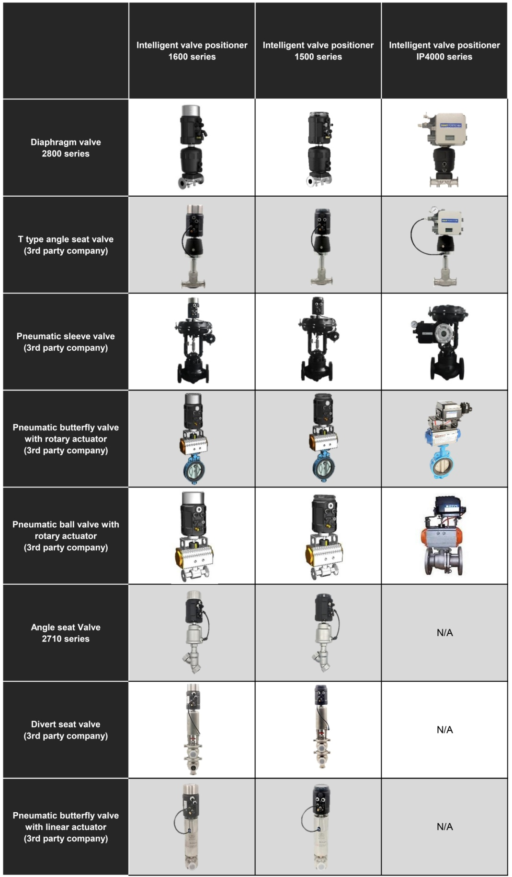
Valve match

Slide 10

1500系列智能电气阀门定位器
电气防水接头
LED状态显示
快速简易启动
技术参数
材料 | 聚碳酸脂（PC）硅橡胶(SI) 聚酰胺(PA6-GF30）
电源 | 直流 24V ±10%
信号输入 | 4 – 20 mA
设定信号输入阻抗 | 120Ω
压缩空气要求 颗粒度要求 颗粒密度要求 凝点要求 油脂浓度要求 | 中性气体, 符合 DIN ISO 8573-1 要求 固体颗粒大小和密度 3 级 露点 3 级 含油量 3 级
环境温度 | 0-70°C
气动接头 | 1/4英寸插入式软管接头(内径Φ 6mm)
电气快速接头 | M12 三针 B标准(电缆直径ø 4-6mm) M12 四针 D标准(电缆直径ø 4-6mm)
气源压力 | 3-7 bar，具体值视执行机构而定
输出气体流量 | 17 l/min(输入压力为0.6Mpa) 58 l/min(输入压力为0.6Mpa, 仅单作用)
阀门行程控制范围 | 直行程5-50 mm 角行程90°
安装方式 | 倾向于安装在执行器顶端，通过螺纹和执行器连接
防护等级 | IP66
功耗 | <5W
1500系列智能电气阀门定位器是专为一体式气动调节阀所设计的，特别适用于角座阀和隔膜阀产品。
该产品操作简便，可轻松通过按键面板进行操作。
定位器可通过检测位移传感器信号，对阀位进行快速精确调节。

Slide 11
组合方式
隔膜式调节阀
角座式调节阀
产品结构
1
防护盖
主壳体
电气接口
气动接口
执行器连接件
2
3
4
5

Slide 12
机械尺寸

Slide 13
操作界面角度调整
将定位器与阀门连接之后，定位器可与阀门之间做角度调整。若需要调整定位器操作界面角度，松开A处的内六角紧定螺钉后，顺时针或逆时针180°范围内调整到需要的角度，再拧紧紧定螺钉。
180°
180°

Slide 14
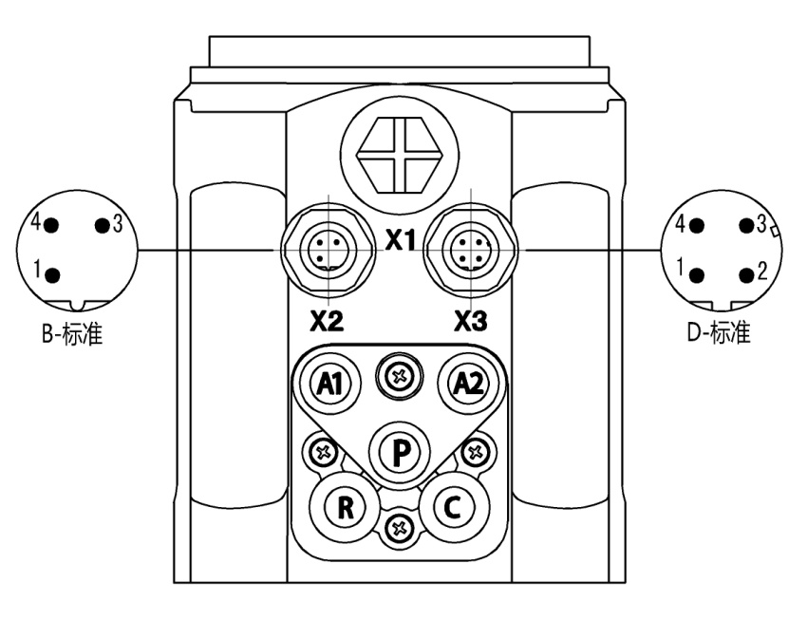
电气接口
X2（可选）
端子号 | 描述 | 信号类型
1 | 模拟信号输出 + | 4 – 20 mA
3 | 模拟信号输出 GND | GND
4 | 空 | 无
X3
端子号 | 描述 | 信号类型
1 | 电源 + | +24 V
2 | 电源GND | GND
3 | 设定信号输入 + | 4 – 20 mA
4 | 设定信号输入GND | GND
气动接口
P | 气源进入（内置滤网，过滤尺寸5μm）
R | 排气
C | 单向阀
A1 | 先导气口1
A2 | 先导气口2

Slide 15
技术规格
N 无反馈信号
Y 4-20mA反馈信号
反馈信号
S 单作用
D 双作用
执行机构类型
S2 直行程5-25 mm
S3 直行程25-50 mm
S4 角行程 90°
阀门最大行程
Q1 17 l/min
Q2 58 l/min
输出气体流量
T1 G1/4
T2 M16 * 1
T3 M22 * 1.5
T4 M26 * 1.5
螺纹规格
S 复位
F 保位
单作用断电状态
1500
N
S
S2
Q1
T1
S
备注：
输出气体流量选项中，代码Q1建议匹配气室内径40-100 mm 的执行器，代码Q2建议匹配气室内径 125-160 mm的执行器。代码Q2仅适用于单作用执行器，且断电时只支持保位状态。代码Q1,Q2标注的气体流量均为输入压力在0.6Mpa下的气体流量。
阀门最大行程选项中代码S4适用的AT执行器范围是AT50~AT125。其他型号请客户咨询我司。如果选择代码S4，则螺纹规格选项不需要选择。
单作用断电状态默认为复位。

Slide 16
信号流程示意图
B1
Z1
阀门开度
CMD
Xd1
E1
位置设定值
位置控制器
先导阀
调节阀
位移测量系统
原理框图
面板操作
输入
输出（可选）
设定信号
4-20mA
定位器
反馈信号
4-20mA
电源
24V 直流

Slide 17
各型号功能对比
功能 | 1600 | 1601 | 1500
防爆 | √ | √ | ×
过程控制 | × | √ | ×
4-20mA信号输入 | √ | √ | √
4-20mA信号输出 | √ | √ | ○
自整定 | √ | √ | √
手动调节阀位 | √ | √ | √
紧闭功能 | √ | √ | √
死区设置 | √ | √ | √
4-20mA输入信号错误检测 | √ | √ | √
恢复出厂设置 | √ | √ | √
特性曲线设置 | √ | √ | ×
信号方向设置 | √ | × | ×
行程限制 | √ | √ | ×
安全位置设置 | √ | √ | ×
开关量信号输入/输出 | √ | √ | ×
输入信号校正 | √ | √ | ×
手动调节速度设置 | √ | √ | ×
密码保护 | √ | √ | ×
√ | 有该功能
× | 无该功能
○ | 可选

Slide 18
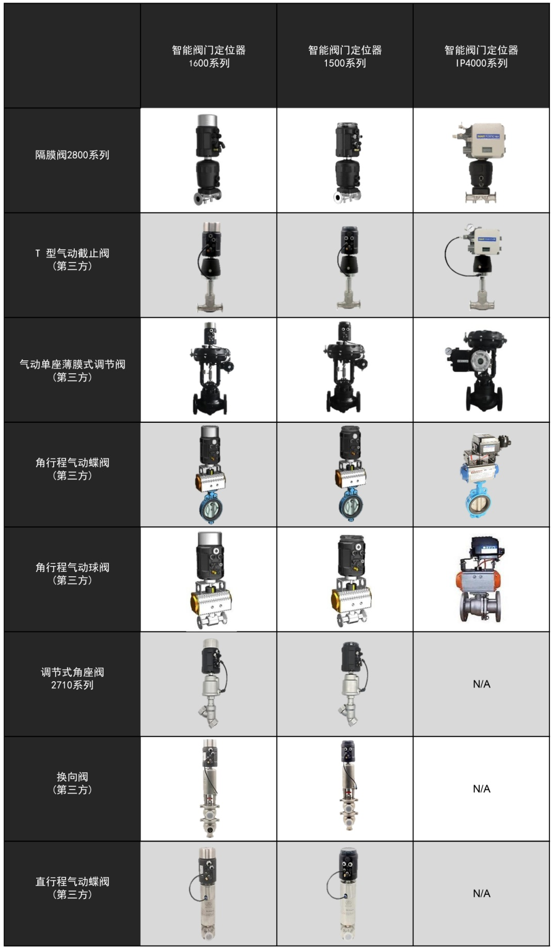
阀门匹配

